Slide 1
Introduction to Matplotlib
Lesson 5.1

Slide 3

Today’s Class
In class this week, we’ll turn Pandas DataFrames into interesting visualizations!
Notes:
-------------------
Image source: AdobeStock_231278849

Slide 4
Class Objectives
By the end of today’s lesson, you will be able to:
01
Use Matplotlib’s PyPlot interface.
02
Create line, bar, and pie charts and scatter plots, and change their appearance.
03
Identify basic plot configuration options, such as xlim and ylim.

Slide 5
Introduction to Matplotlib

Slide 6
What Is Matplotlib?

Slide 7
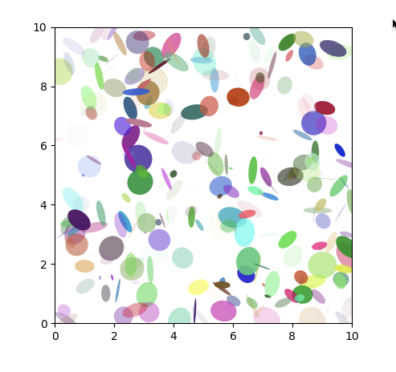
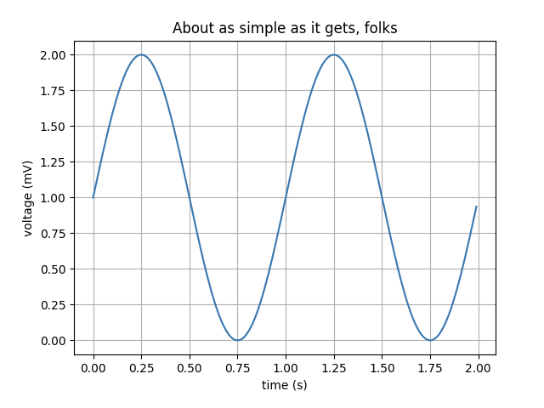
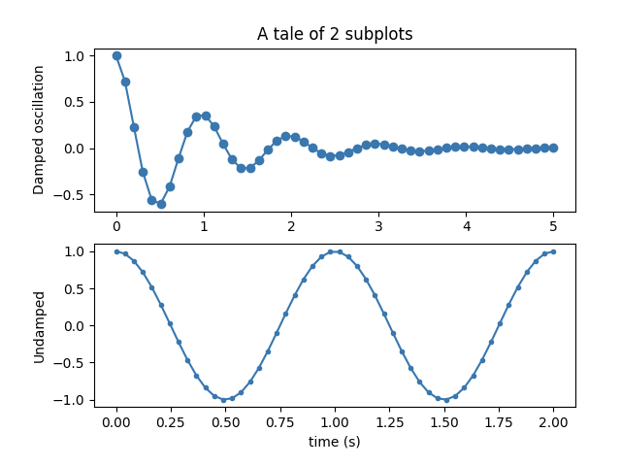
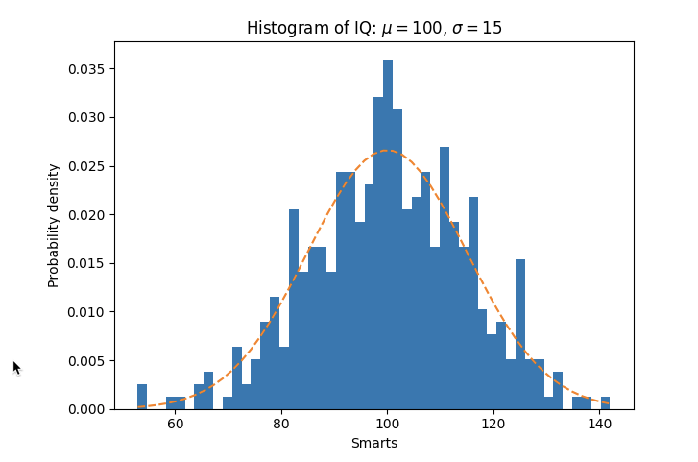
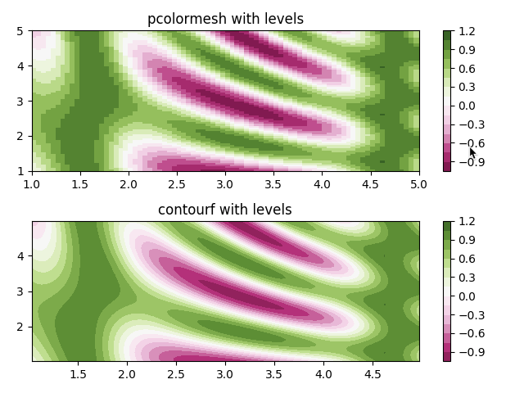
Matplotlib: A Python Library That Visualizes a Dataset
Types of datasets include:
Pandas DataFrames
Lists, tuples, and dictionaries
NumPy arrays
Types of visualizations include:
Bar charts
Pie charts
Line charts
Scatter plots

Slide 8
The PyPlot Module = The Heart of Matplotlib
Accepts many forms of input values.
Enables custom colors, shapes, labels, etc.
Does most of the plotting logistics for us; we simply tell it which plot to make.
Trust us: you’ll love it!

Slide 9
PyPlot
General Plotting Process with PyPlot:
Create your dataset. | Data can be generated from functions, pulled from Pandas DataFrames, etc.
Generate your plot. | Use the pyplot.plot() function to tell Matplotlib what data to use and which plot to make.
Customize your plot. | Change the axis, label the figures, color the data points—make the plot as informative to the reader as possible.

Slide 11
Activity: New Jersey Weather
In this activity, you will create a series of line plots by using New Jersey temperature data.
15 minutes

Slide 12
Activity: New Jersey Weather
Instructions | Using the following data, plot the monthly averages for temperature in New Jersey: Use the numeric value for months. Average temperature per month in Fahrenheit: [39, 42, 51, 62, 72, 82, 86, 84, 77, 65, 55, 44]
 | Use list comprehension to convert the temperature to Celsius, and plot that line as well.
 | Create a third plot that includes both lines.
Hints | The formula to convert Fahrenheit to Celsius is: C = (F﹣32) * 0.56
 | Check the Matplotlib documentation for more information about the PyPlot library.

Slide 14
Configuring Line Plots

Slide 15
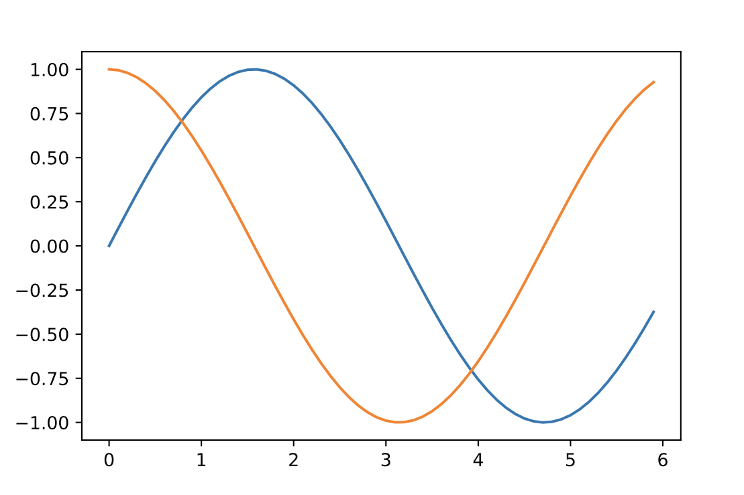
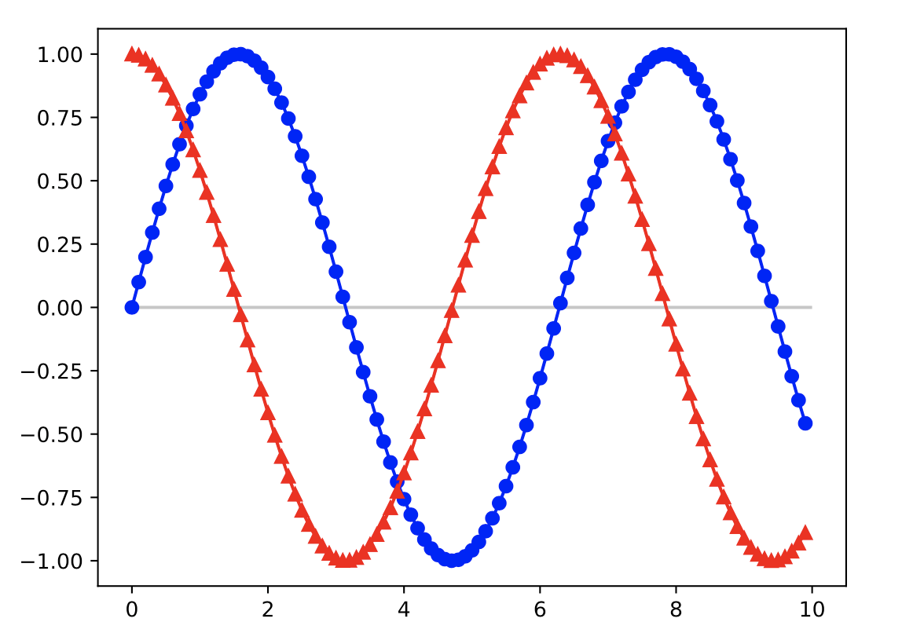
Basic Line Plots
Matplotlib’s basic line plots are rather bland.
Custom colors
Custom markers
Reference Lines

Slide 16
Basic Line Plots
color='red' or 'blue'
marker ='o', '^'
plt.hlines()

Slide 17
Activity: Legendary Temperature
In this activity, you will edit the line plots created earlier to make them more visually interesting.
15 minutes

Slide 18
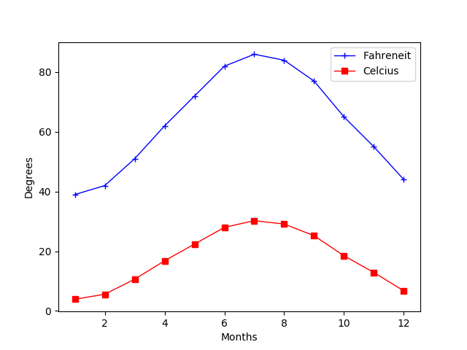
Legendary Temperature Instructions
Instructions | Modify the New Jersey temperature line charts you created earlier
 | Add a legend to indicate the Fahrenheit temperatures and Celsius temperatures
 | Once you have created the plot, use the Matplotlib documentation to find additional formatting that could be added to the chart.
Fahrenheit
Celsius

Slide 20
Aesthetics

Slide 21
The best plots, like the best code, are easy to read.

Slide 22
How can we improve the readability of plots?

Slide 23
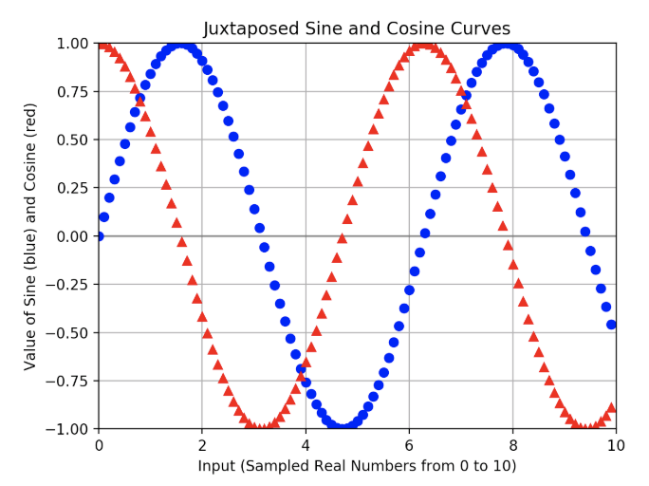
Steps to Improve Readability of Plots
01
02
03
Add labels to the
x- and y-axes.
Add titles to plots.
Limit the boundaries of the x- and y-axes.

Slide 24
Changing Aesthetics in PyPlot
01
02
03
Add labels to the
x- and y-axes.
Add titles to plots.
Limit the boundaries of the x- and y-axes.
plt.xlabel()
plt.ylabel()
plt.title()
plt.xlim()
plt.ylim()

Slide 25
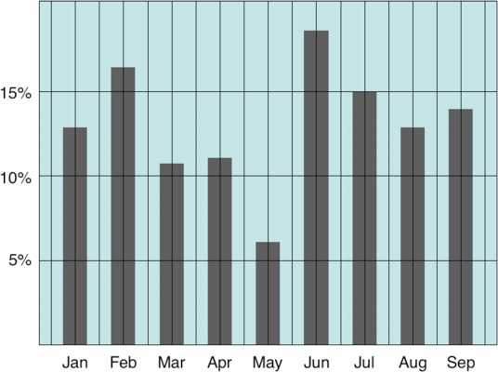
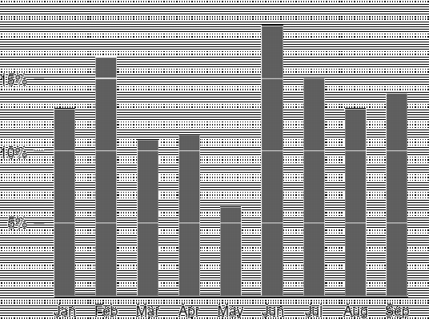
Advantages of Adding Aesthetics
Adding labels makes graphics easier to understand and prevents them from being unintentionally misleading.
Limiting the range of the plot maximizes the data-to-ink ratio:
“Ink” used to make data ÷ Total “ink” of the plot
It’s best to use the least amount of ink to show the most amount of data.
Low data-to-ink ratio
High data-to-ink ratio
Notes:
-------------------
More info on the data-to-ink ratio can be found here: https://infovis-wiki.net/wiki/Data-Ink_Ratio
Image sources: Low ratio (http://www.tbray.org/ongoing/data-ink/di1), High ratio (http://www.tbray.org/ongoing/data-ink/di5)

Slide 26
Notes:
Return to the lesson plan and continue with the instructions for the remainder of the activity.

Slide 27
Activity: Coaster Speed
In this activity, you will create a line chart that graphs the speed of a roller coaster over time. You will then style the chart and add aesthetics to it.
10 minutes

Slide 28
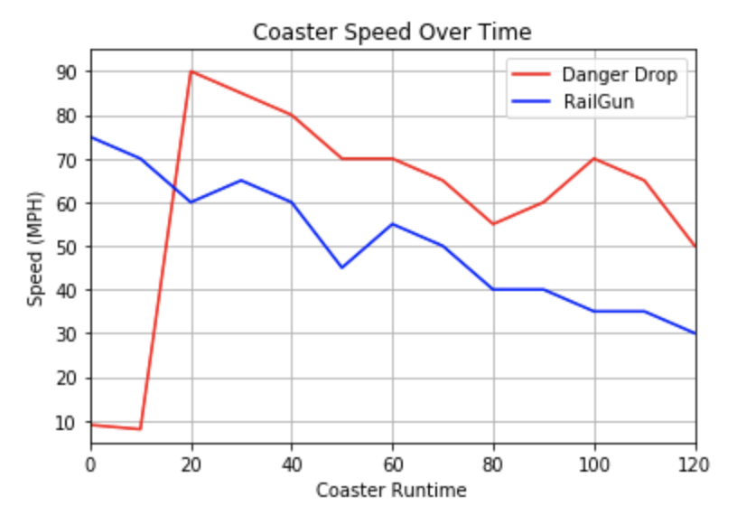
Coaster Speed Instructions
Create a line chart with two plots by using the following data:
Danger Drop | [9, 8, 90, 85, 80, 70, 70, 65, 55, 60, 70, 65, 50]
RailGun | [75, 70, 60, 65, 60, 45, 55, 50, 40, 40, 35, 35, 30]
Both coasters are 120 seconds long, and the speed was measured every 10 seconds.
Apply styling and labels that match the image provided.

Slide 30

Notes:
-------------------
Image source: AdobeStock_56885471

Slide 31
Different Plots

Slide 32
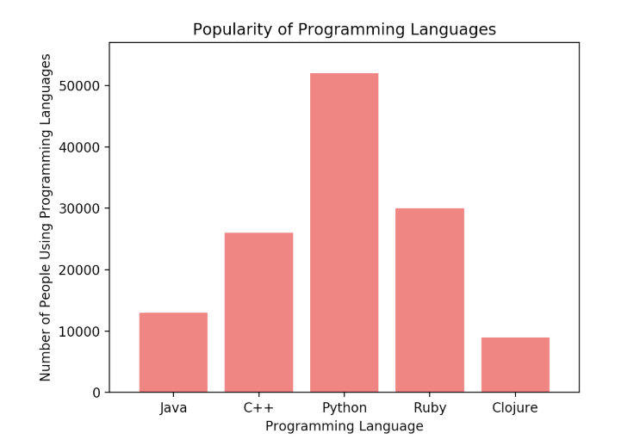
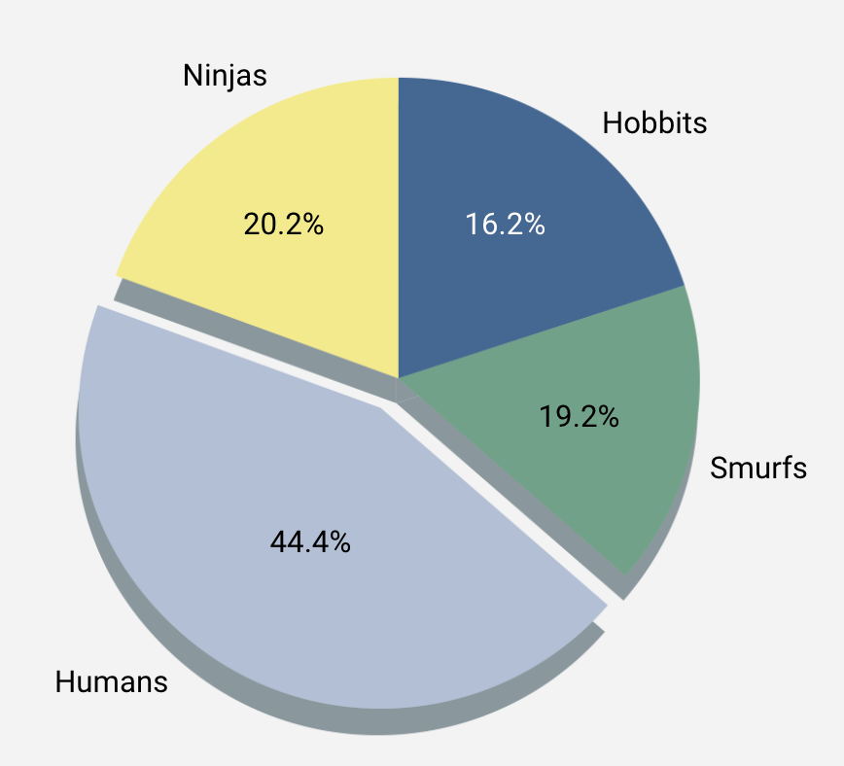
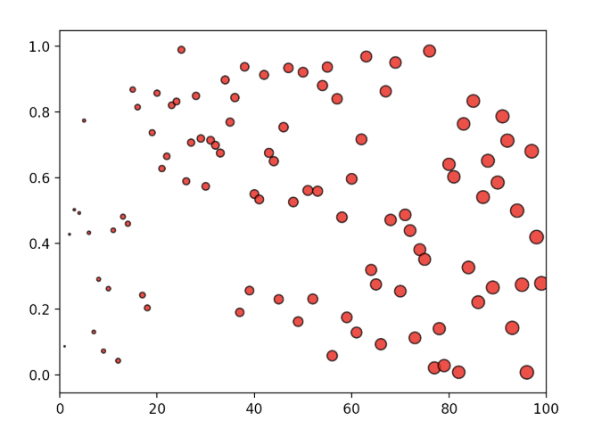
Matplotlib: Not Just for Line Plots!
Bar Charts
Pie Charts
Scatter Plots
Useful for comparing different entities to one another
Useful for demonstrating different elements of a complete dataset
Useful for displaying where values fall with respect to two factors

Slide 33
It’s important to choose the right plot for a given dataset!

Slide 34
Bar Charts

Slide 35
Bar Charts Help to Visualize Univariate Data
Univariate data refers to data with one variable, or one type of measurement.
Examples:
Amount of rainfall in inches
Number of votes in a poll
Number of people per category
Bar charts are particularly useful when a single variable is being counted multiple times.

Slide 36

Bar Charts
Bar charts are NOT effective for visualizing bivariate data.
Bivariate data refers to data with two variables. Anything you can plot as a line or scatter plot is bivariate data. | Example: A dataset comparing the number of ice cream bars sold with the daily temperature.

Slide 37
Think of other examples where
a bar chart would be effective.

Slide 39
Activity: Cars Bar Chart
In this activity, you will create a bar chart that visualizes the density of commuting cars per 1,000 population aged 16 and over within major U.S. cities.
10 minutes

Slide 40
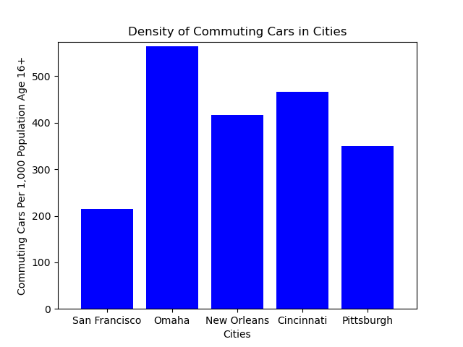
Activity: Cars Bar Chart
Using the provided starter code in your folders, recreate the figure as shown.
File: Unsolved/py_bars.ipynb

Slide 42
Pie Charts

Slide 43
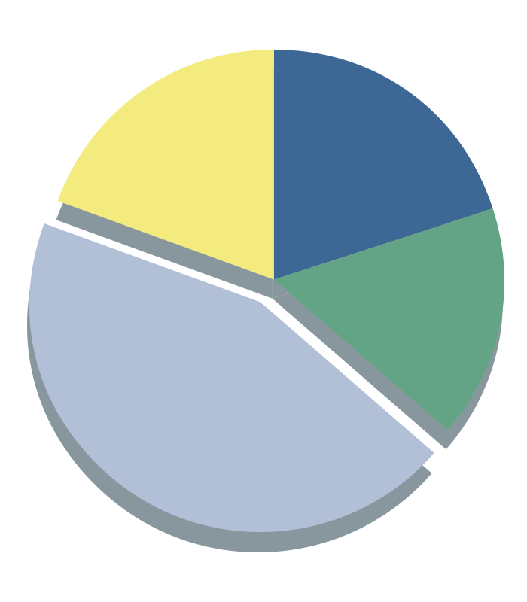
Pie Charts Help Visualize Simple Categorical Data
Pie charts are great for visualizing data that is percentages, or proportions.
For example:
Ninjas
Hobbits
Proportion of Democrat versus Republican versus independent voters
20.2%
16.2%
Percentages for children’s favorite story characters
Distribution of left-handed versus right-handed pitchers in baseball
19.2%
Smurfs
Fewer categories increase the effectiveness of a pie chart.
44.4%
Humans

Slide 44
Pie charts
Pie charts are NOT effective for large or multivariate datasets.
01
02
03
With more than ~10 categories, pie charts become too crowded and lose effectiveness.
Like bar charts, pie charts are only effective for visualizing univariate data.
When in doubt, just use a bar chart.

Slide 45
Think of other examples where a pie chart would be effective.

Slide 47
Activity: Pies Pie Chart
In this activity, you will create a pie chart that visualizes pie flavor preferences in the United States.
10 minutes

Slide 48
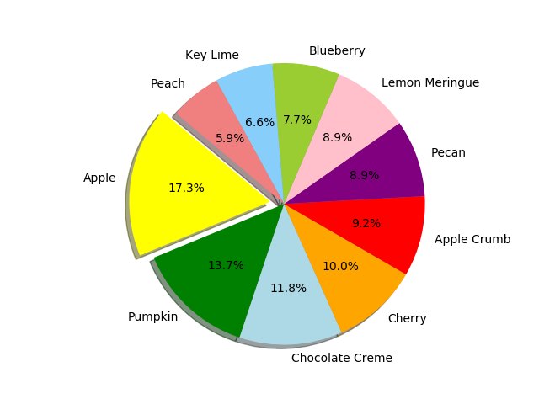
Pies Pie Chart Instructions
Using the provided starter code
in your folders, recreate the figure as shown.
File: Unsolved/py_pie.ipynb

Slide 50
Scatter Plots

Slide 51
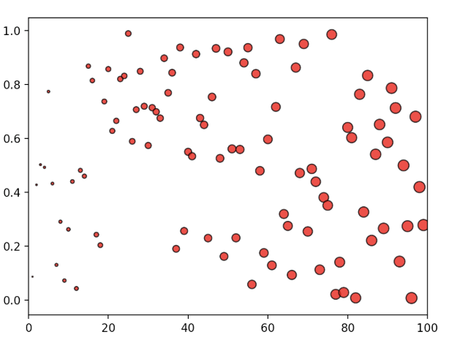
Scatter Plots = Powerful Visualizations for Bivariate Data
Bivariate data refers to data with two variables.
Each data point is a combination of two variables.
Anything plotted on an x- and y-axis is bivariate data.
Example: The amount of ice cream sold versus daily temperature
Scatter plots are helpful for visualizing large datasets (with thousands of data points).
Scatter plots are frequently used to visualize clustering in a dataset.

Slide 52
Scatter plots
Scatter plots are NOT effective for continuous measurements.
01
02
03
When data is continuous, we’ll often want to interpolate between measurements.
The most common continuous data is time series data.
Scatter plots visualize “scattered” data, so interpolation is almost impossible.
Line plots allow the audience to read between the data points.

Slide 53
Think of other examples where a scatter plot would be effective.

Slide 55
Activity: Scatter Py
In this activity, you will create a scatter plot that visualizes ice cream sales in comparison to temperature increases.
10 minutes

Slide 56
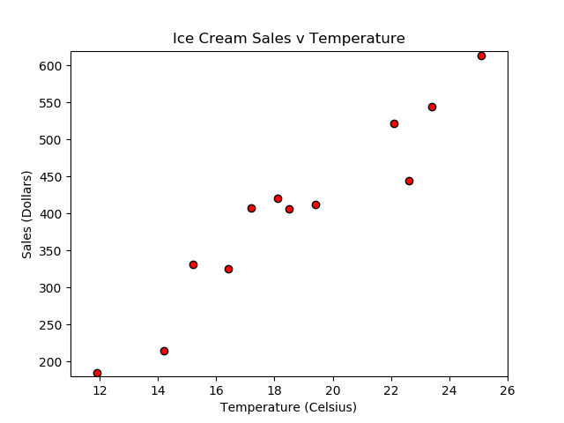
Activity: Scatter Py
Instructions | Using the provided starter code in your folders, recreate the figure as shown.
 | File: Unsolved/ice_cream_sales.ipynb
Hints | Create a new list called scoop_price, fill it with values, and then set it so that the size of the dots are set according to those values.

Slide 58
We’re almost there!
Just one more activity!
Notes:
Image source: AdobeStock_139102602

Slide 59
Activity: Average Rainfall
In this activity, you will create a bar chart that shows the average rainfall in different states by importing data from a CSV file.
15 minutes

Slide 60
Activity: Average Rainfall
Instructions | Examine the raw data in your Resources folder. This dataset contains the average rainfall per state in any given year. File: Resources/avg_rain_state.csv
 | Using the file provided as a starter, generate a plot of the average rainfall per state. File: Unsolved/avg_state_rain.ipynb
Hints | Think critically about the different plots that we discussed today. Ask yourself which type of plot summarizes the data most effectively.
 | Be sure to add a title, axis labels, and any other aesthetics that may help make the visualization more effective.

